Slide 1






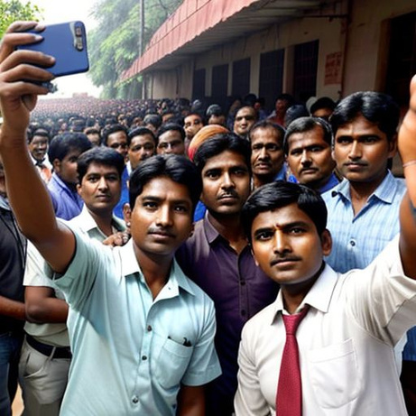




Dihaadi
School of Computer Science and Engineering
Department of Computer Science and Engineering
Submitted By: Krisha Kohli
Reg. No: 2427030094
Supervised By: Dr. Sayar Singh Shekhawat
आज की मेहनत, कल की बरकत।

Slide 2
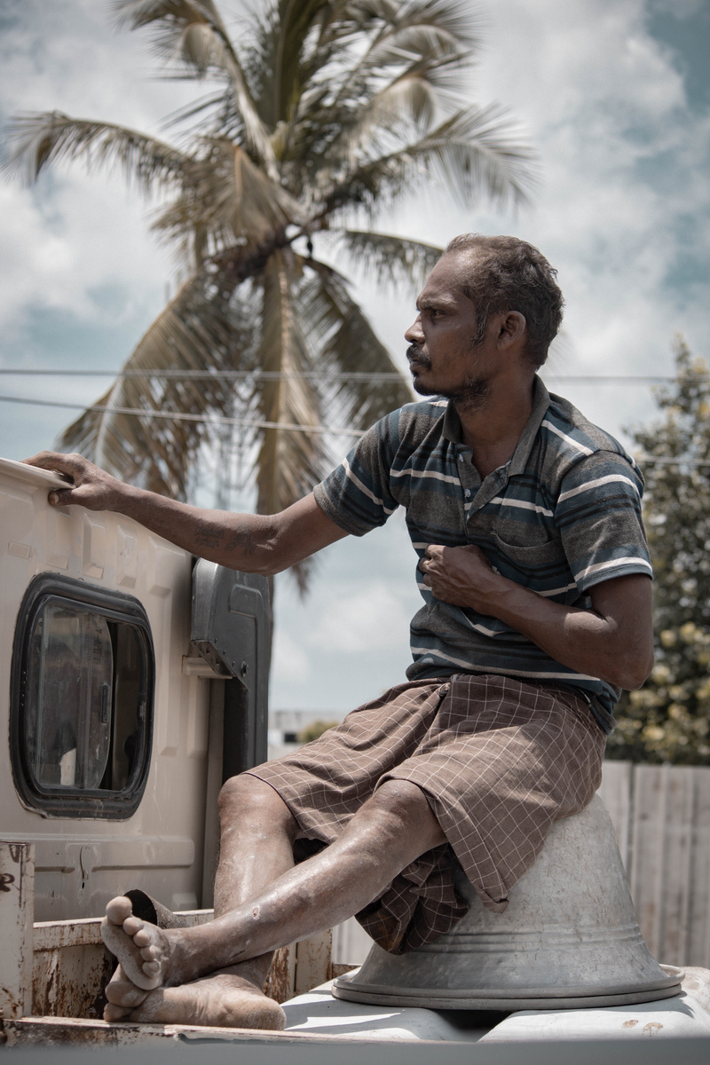
Outline
Introduction
Literature Review
Problem Statement
Proposed Solution
Objectives

Slide 3


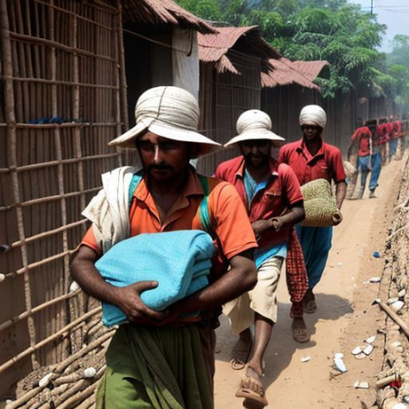


Introduction
India’s daily wage workforce faces unstable income and no job security.
Lack of access to hygienic food, healthcare, and fair wages.
Dihaadi aims to digitize the informal labour market through an all-in-one mobile platform

Slide 4
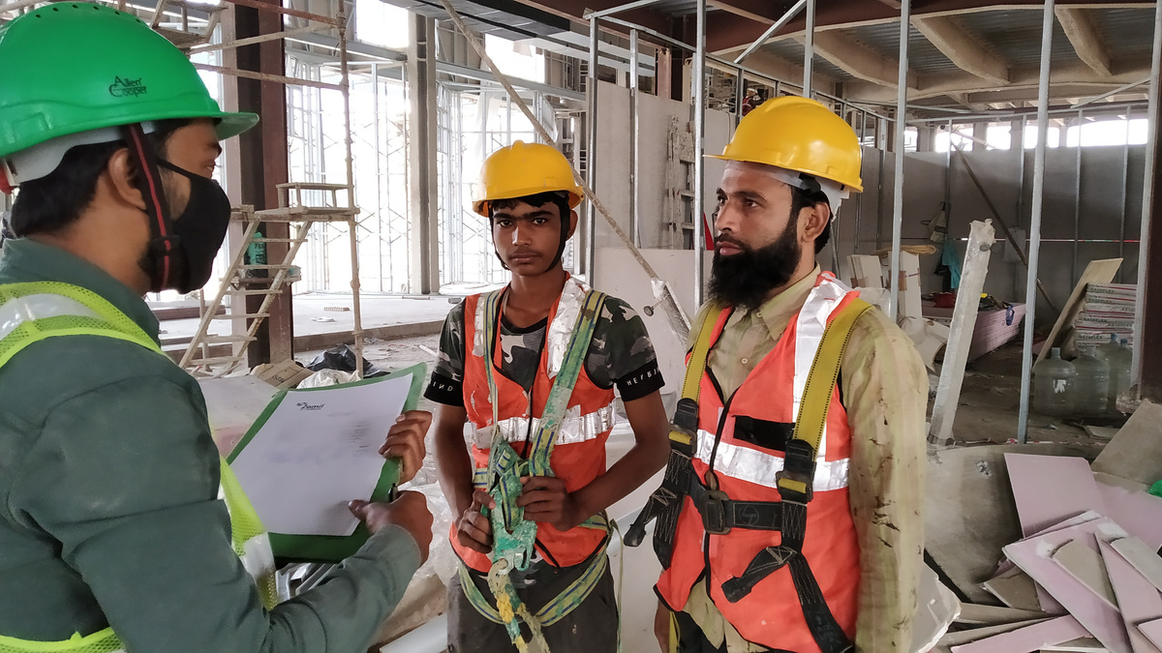
Introduction
Bridges the gap between labourers and employers.
Provides access to verified jobs, digital payments, ratings, and reviews.
Focuses on empowerment and social upliftment of blue-collar workers.

Slide 5

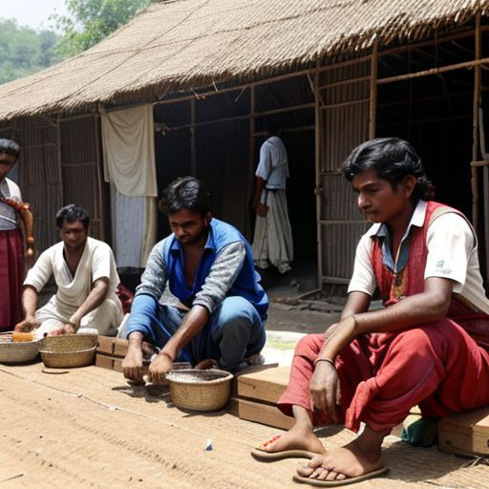
Literature Review
Existing job portals focus only on skilled labour.
No major digital ecosystem exists for daily wage workers.
Dihaadi fills this gap by integrating employment, welfare, and financial tools

Slide 6
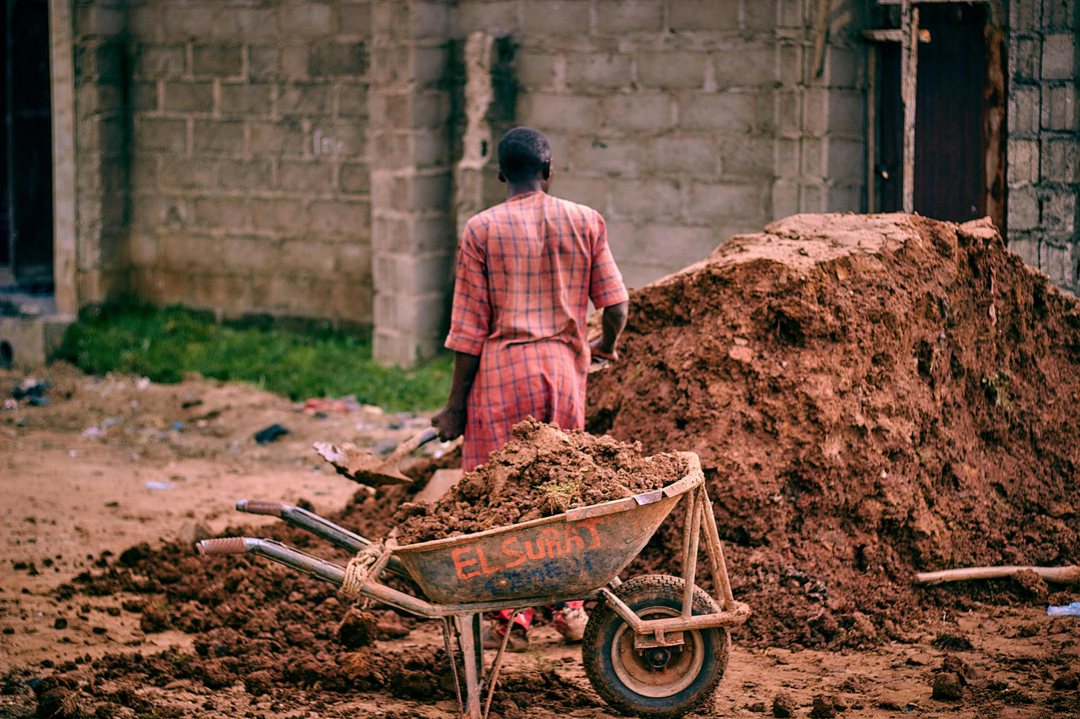
Literature Review
Studies show that over 90% of India’s workforce is part of the unorganized sector, yet digital inclusion among daily wage earners remains minimal.
Existing labour apps focus mainly on construction contractors or skilled freelancers, offering no stable employment channel for daily wage workers.
NGOs and local agencies provide short-term aid, but there’s no integrated model combining job discovery, welfare, and digital payments.
Dihaadi uniquely combines technology-driven job allocation, worker welfare, and community upliftment, addressing both economic and humanitarian needs.

Slide 7
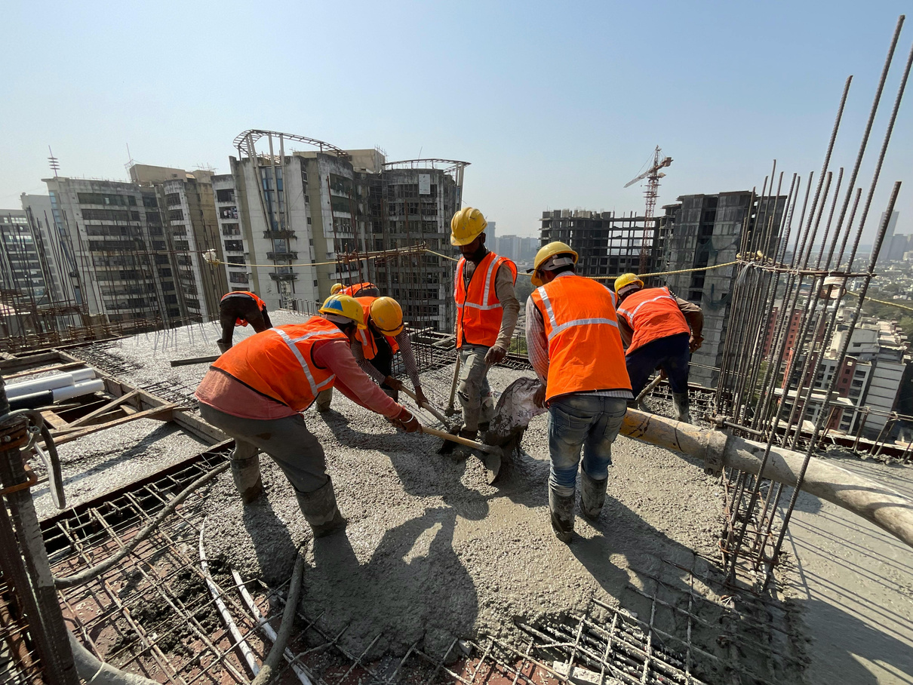
Problem Statement
Daily wage labourers in India struggle with job instability, lack of fair wages, and poor working conditions due to the absence of a unified employment platform.

Slide 8

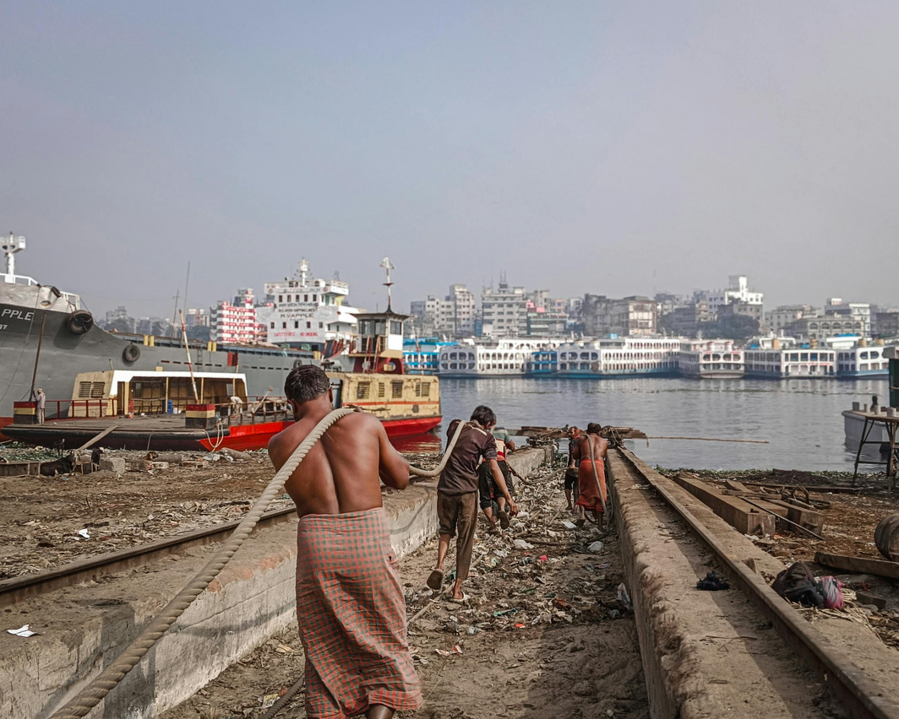
Solution: Dihaadi!
Proposed Solution – Concept
Dihaadi is a mobile-based platform connecting labourers and employers.
Provides job listings, worker profiles, and ratings/reviews for credibility.
Integrates digital payments, location tracking, and feedback systems.

Slide 9
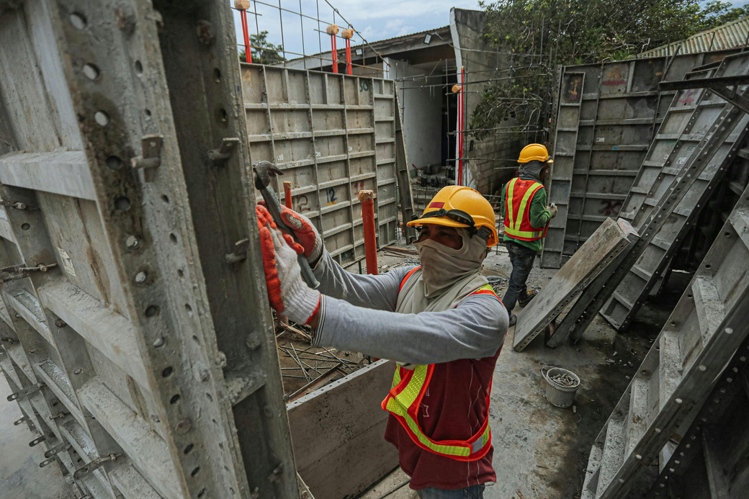
Solution: Dihaadi!
Proposed Solution – Working flow
Customer posts a job request on Dihaadi app.
Market representative verifies the demand.
App recommends top-rated nearby labourers.
Customer selects and negotiates wages.
Job is completed → digital payment → worker rating.

Slide 10
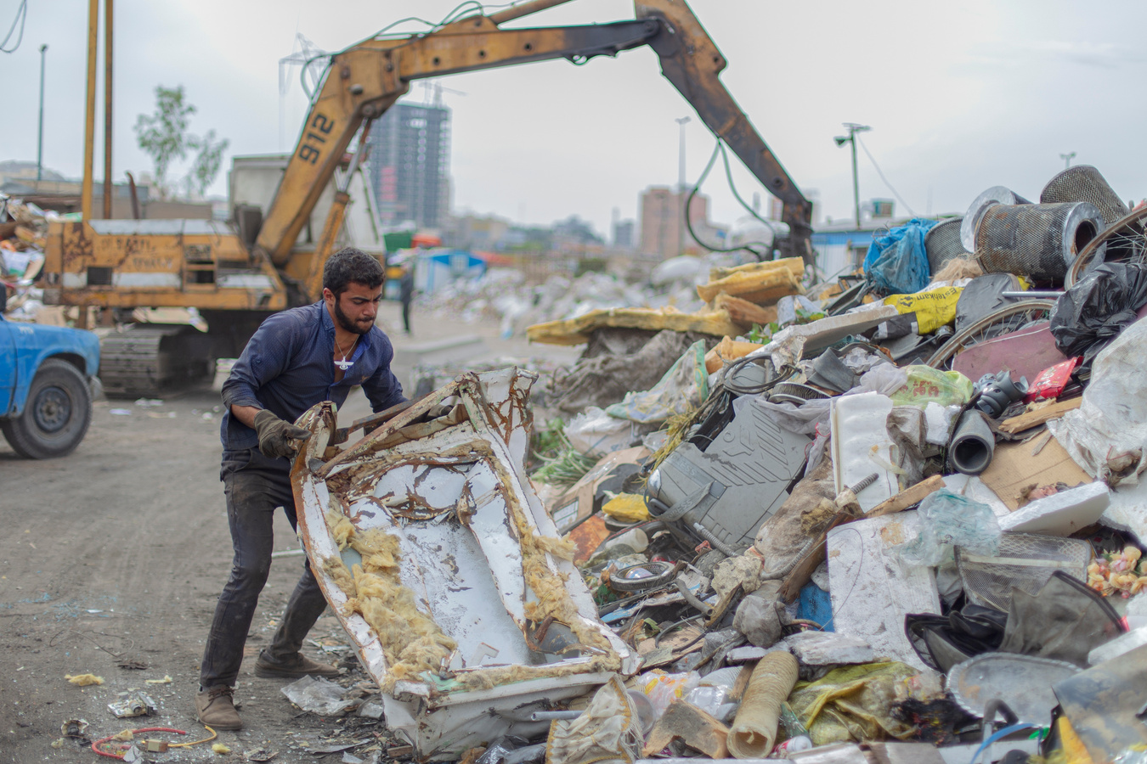
Solution: Dihaadi!
Proposed Solution – Features
User-friendly interface for all literacy levels.
Verified labourers with background details.
Skill-based filtering and real-time job tracking.
In-app wallet for safe and instant transactions.
Multilingual support for inclusivity

Slide 11



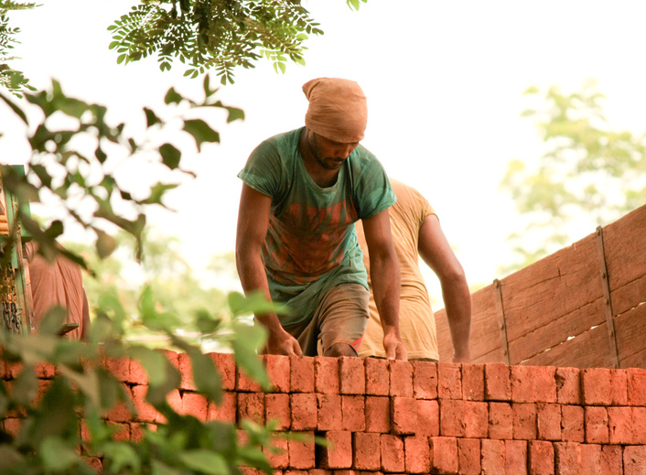

Objectives
Provide reliable employment opportunities to daily wage earners.
Promote skill development through workshops.
Enable transparent communication and payment systems.
Build a digitally connected, self-sustaining labour ecosystem.

Slide 12
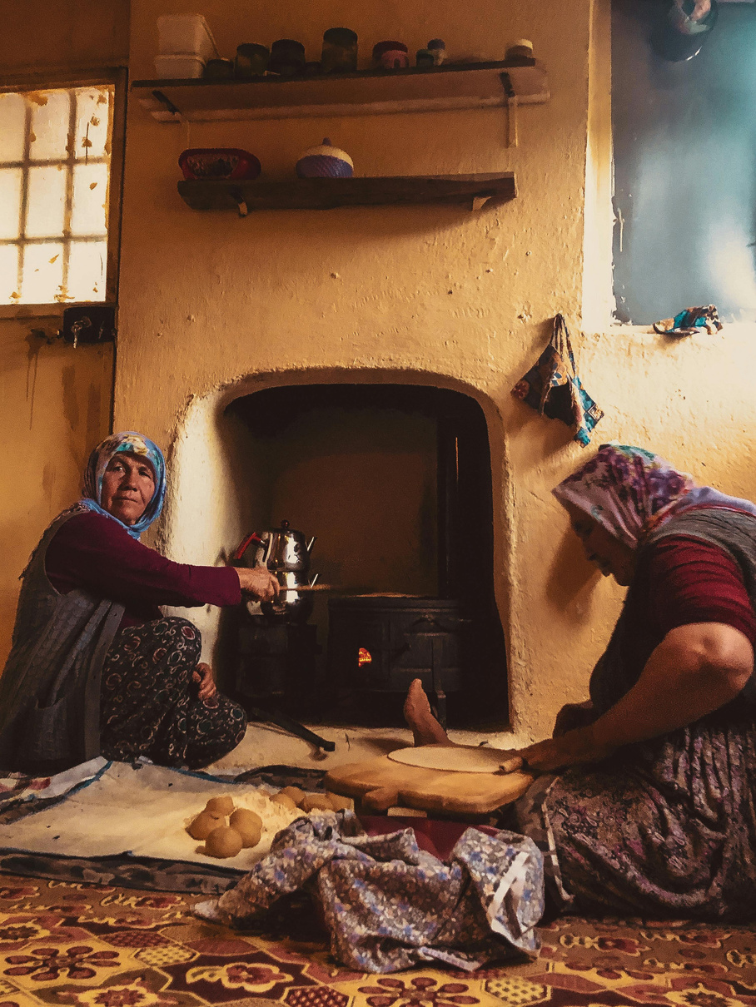
Objectives
To digitize the informal labour market by connecting workers and employers through a single trusted platform.
To improve living standards by providing access to healthcare, food, and financial assistance services through partner tie-ups.
To introduce AI-driven job matching that aligns worker skills with suitable opportunities.
To empower labourers through awareness, digital literacy, and financial inclusion.
To collaborate with NGOs and local governments for sustainable growth and social welfare of workers.

Slide 13



Our process
01
03
04
02
Market Representative
The service request goes to our market representative who sends the user the names of the top-rated labourers in their area.
Customer
The customer selects and books a Services from the variety of services available on our platform.
Assignment
Labour
The labour is managed either with to and fro fare by the company (for distances up to 2 km) or by the customer.
Once the customer decides upon the Labourer/s of their choice based on their merits that labour will connect the customer via call for the negotiation in wages prior.

Slide 14


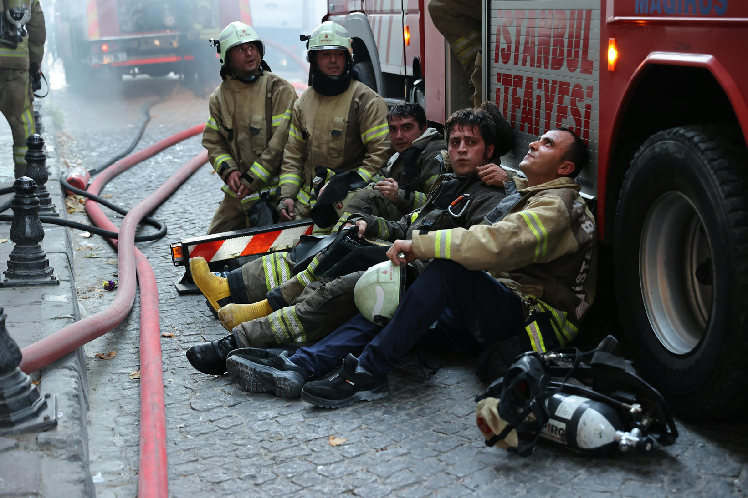

References
Ministry of Labour & Employment, Government of India — e-Shram Portal Report 2023.
2. International Labour Organization (ILO) —Informal Economy in India: Status and Challenges, 2022.
3. NITI Aayog — India’s Gig and Platform Economy Report, 2022.
4. Economic Times — “India’s Unorganized Workforce: The Digital Divide”, August 2023.

Slide 15
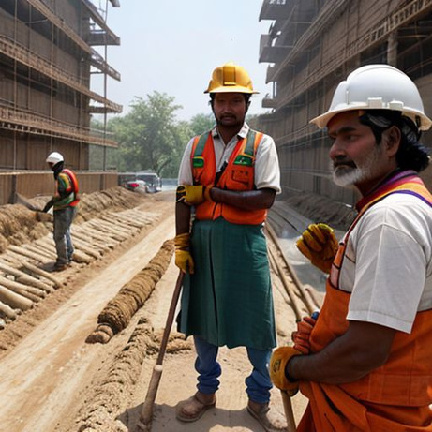




Do you have any questions?
krishakohli001@gmail.com
+91 9984992183
dihaadi.com
Thank you

